Slide 1
SQL

Slide 2
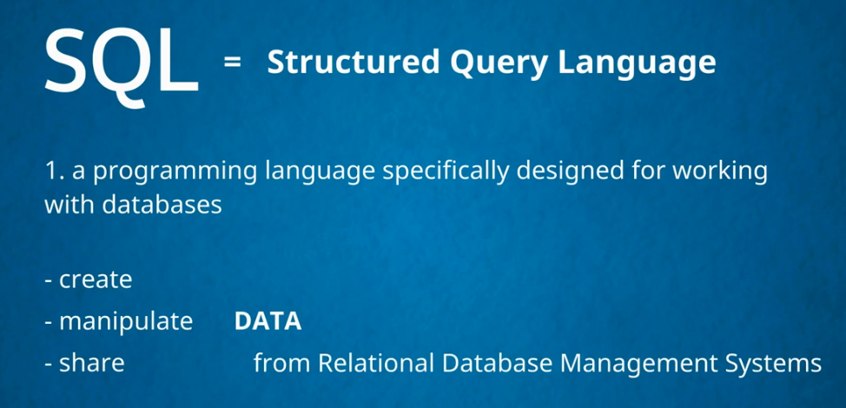

Slide 3


Slide 4
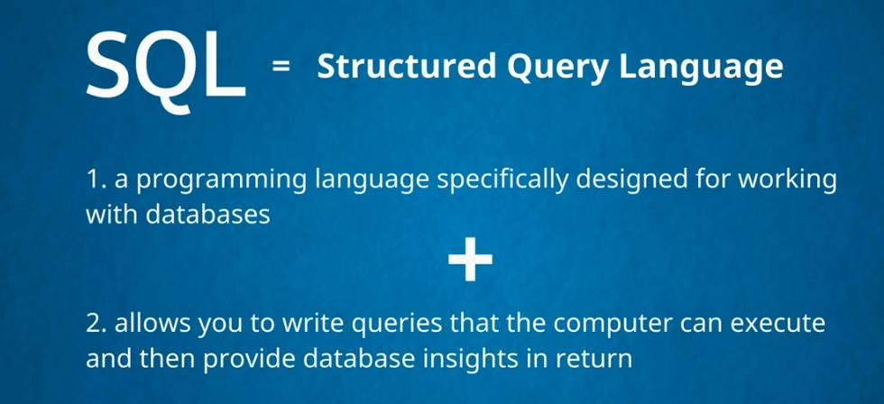

Slide 5


Slide 6
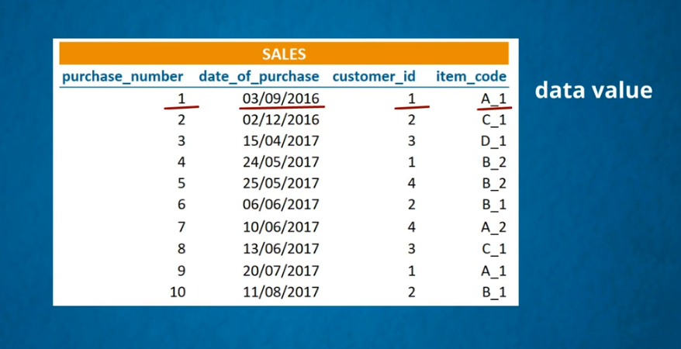

Slide 7
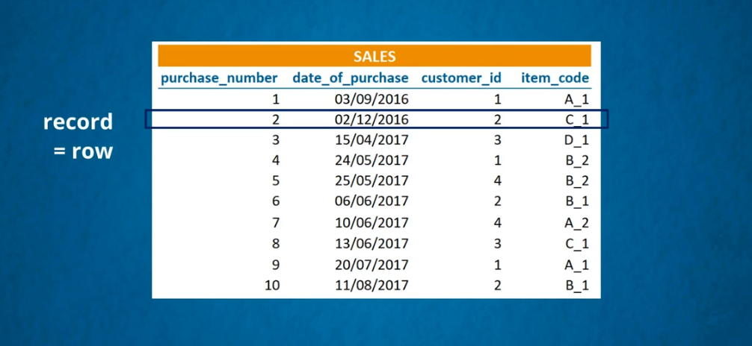

Slide 8
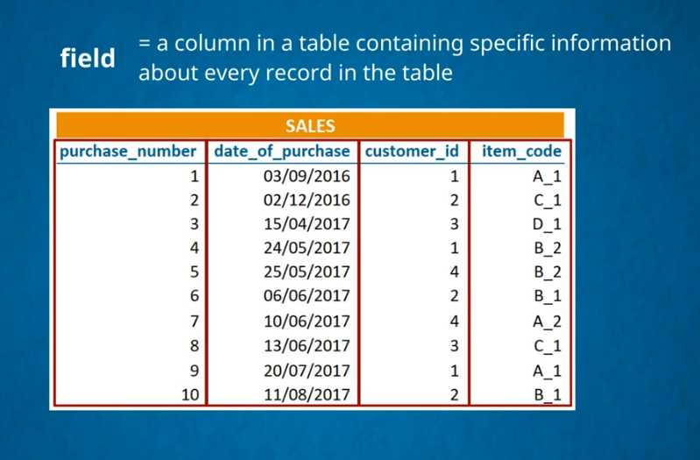

Slide 9
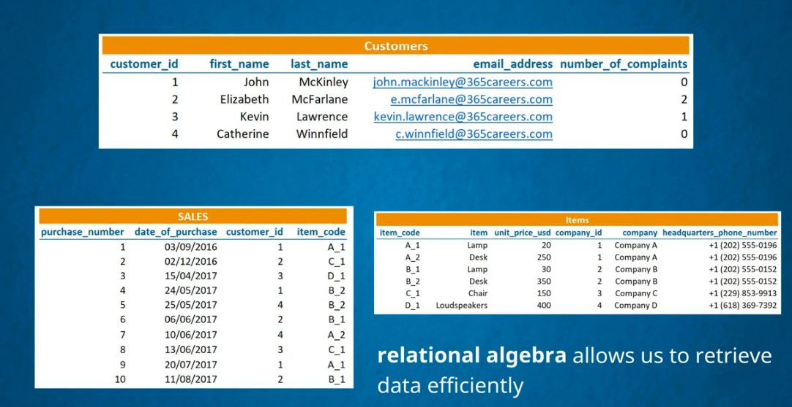

Slide 10
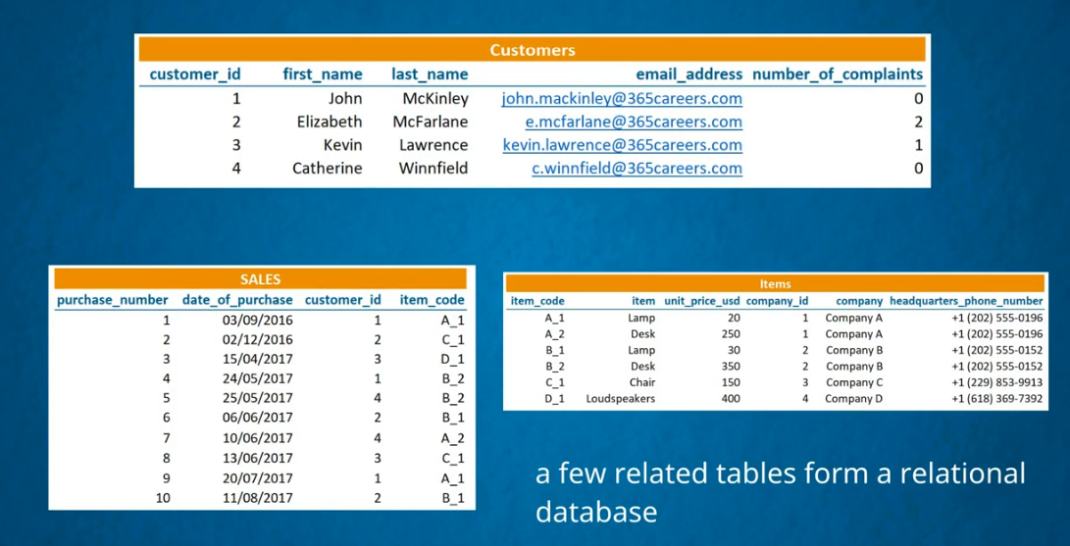

Slide 11
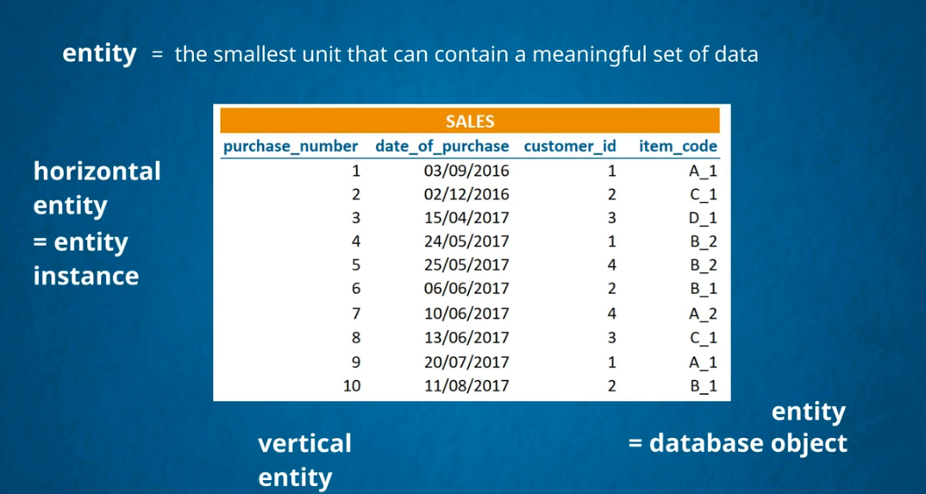

Slide 12
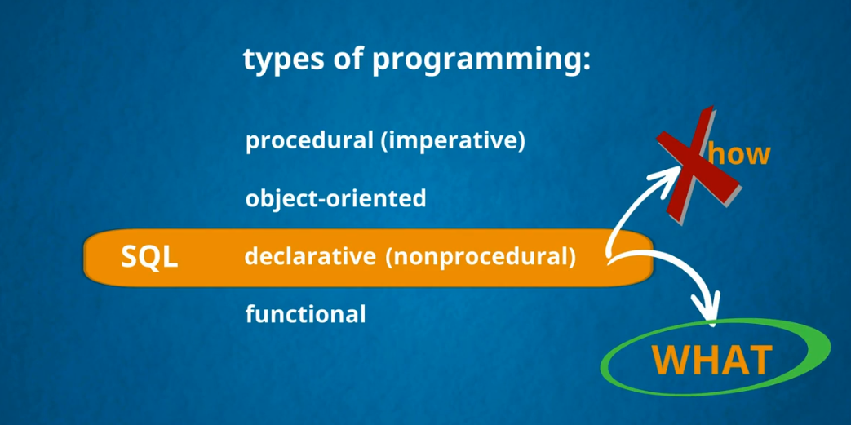

Slide 13
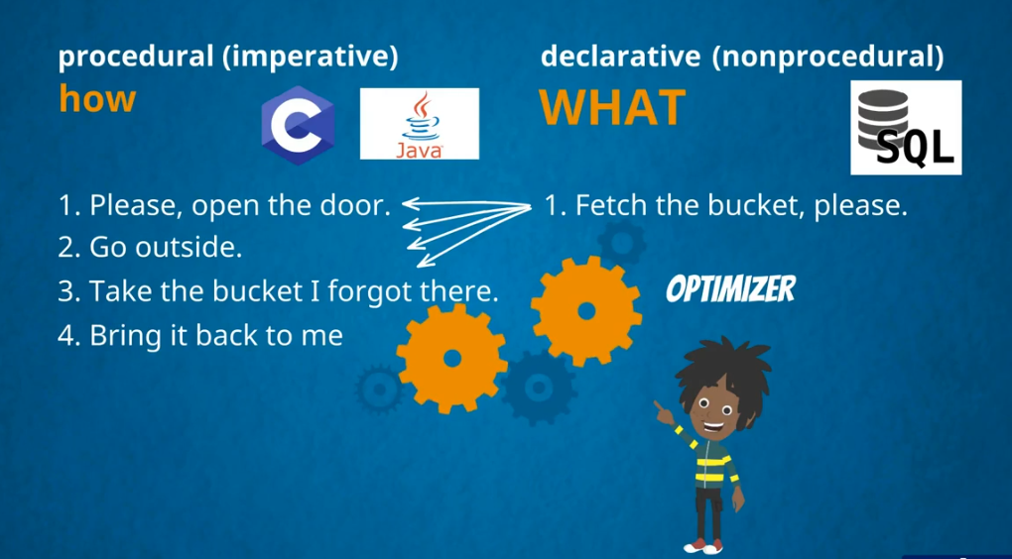

Slide 14
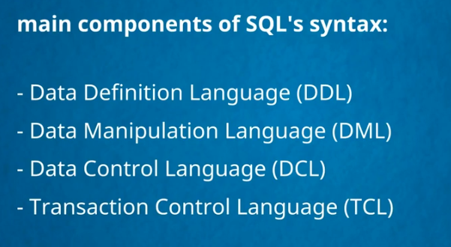

Slide 15
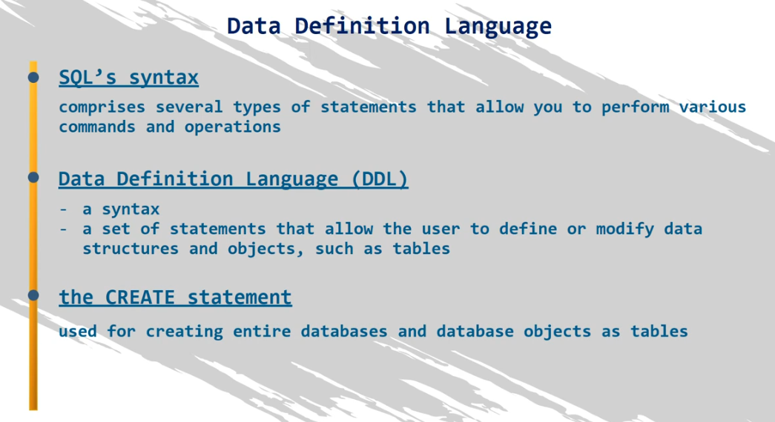

Slide 16
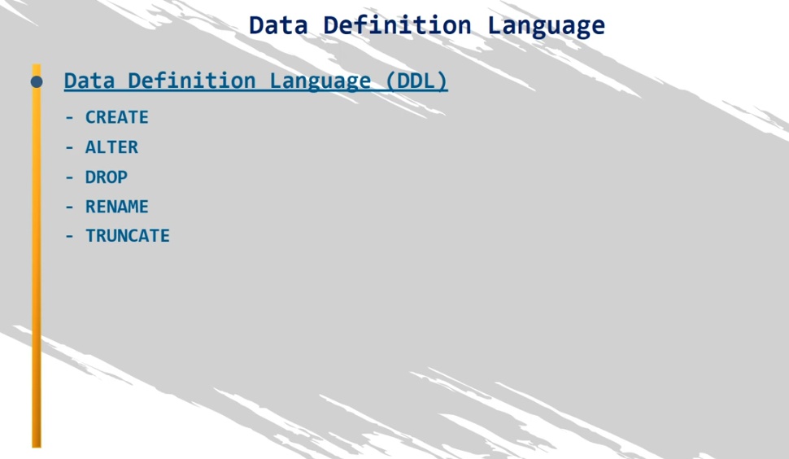

Slide 17
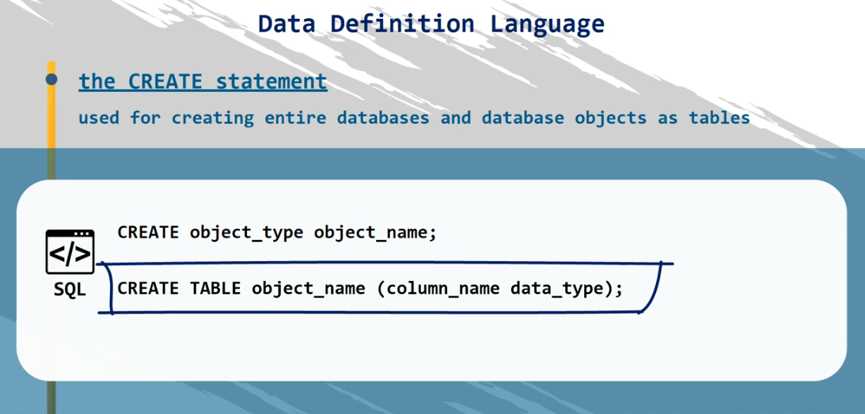

Slide 18
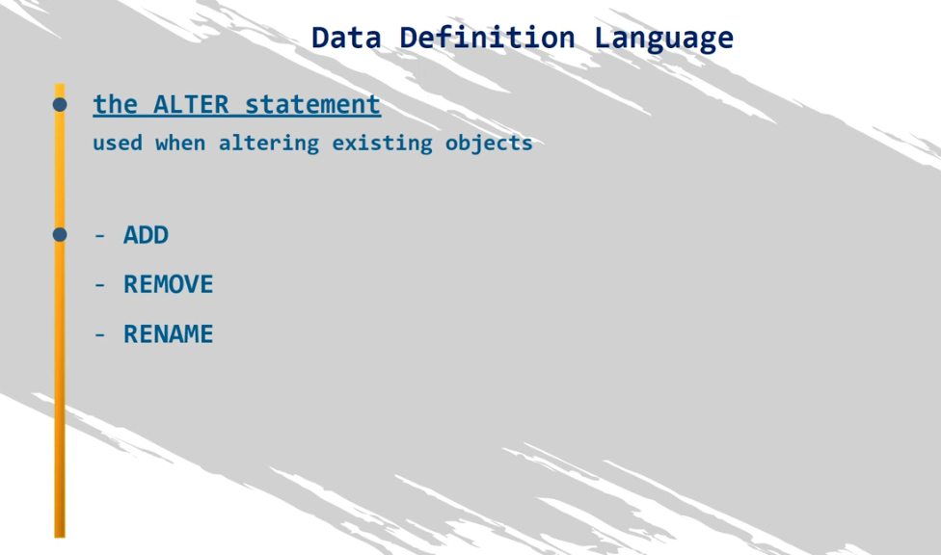
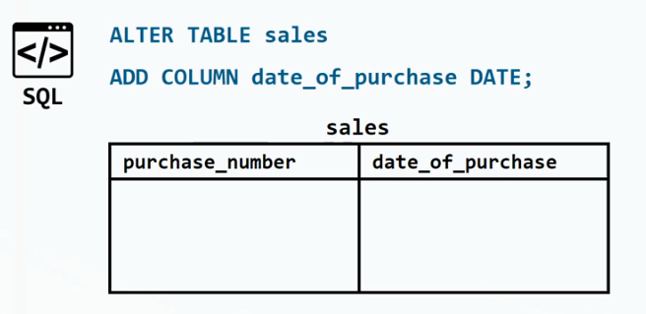

Slide 19
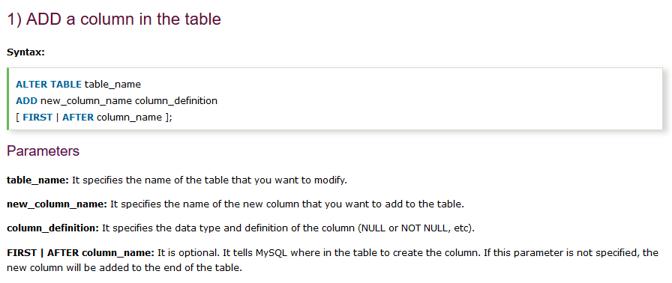

Slide 20
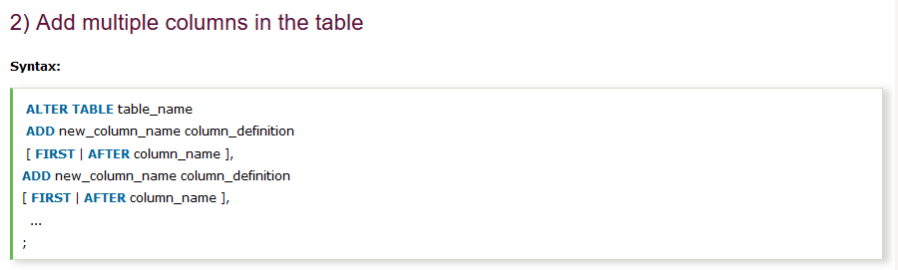
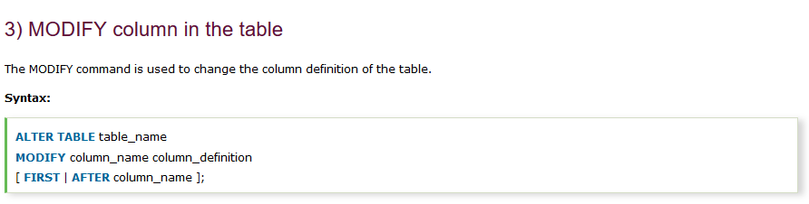

Slide 21
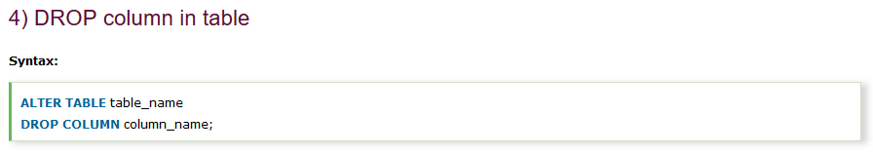
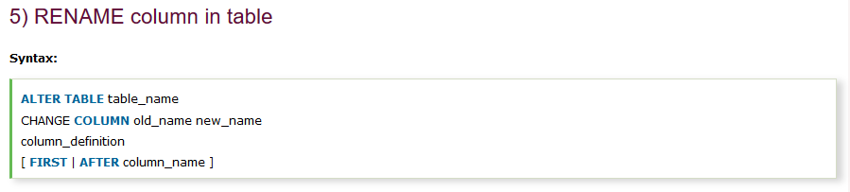

Slide 22
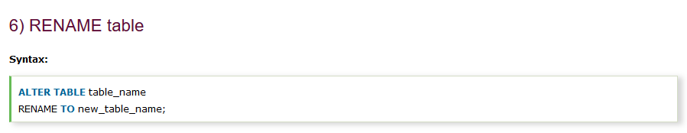

Slide 23
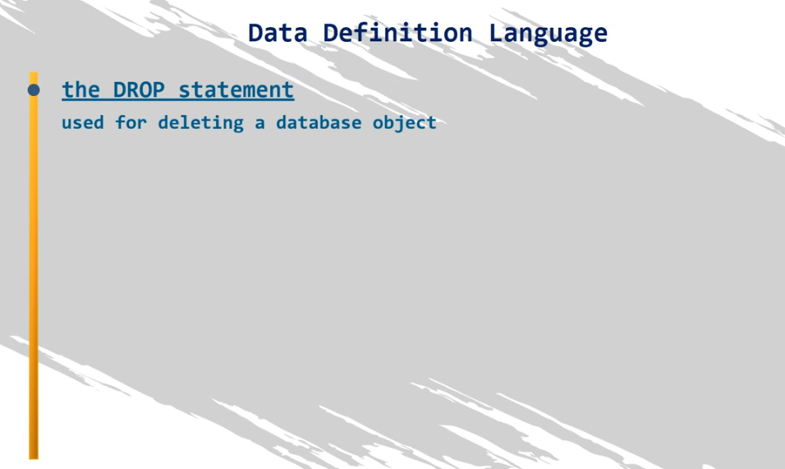
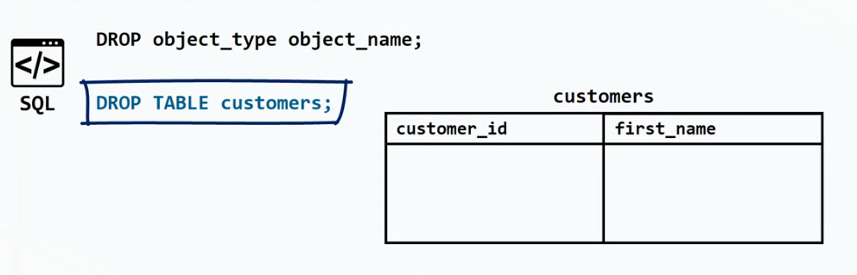

Slide 24
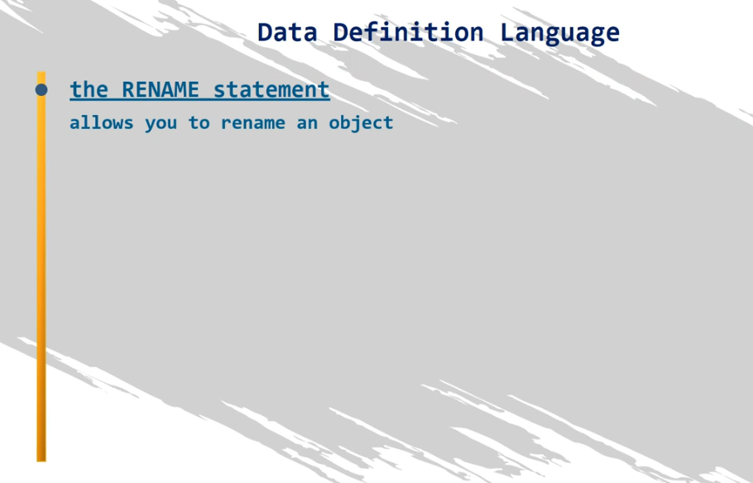
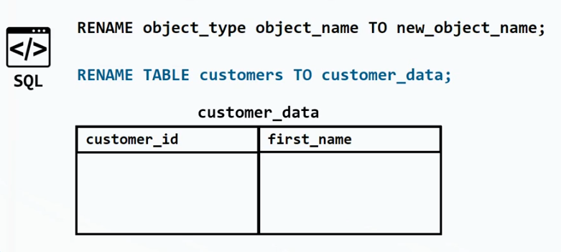

Slide 25
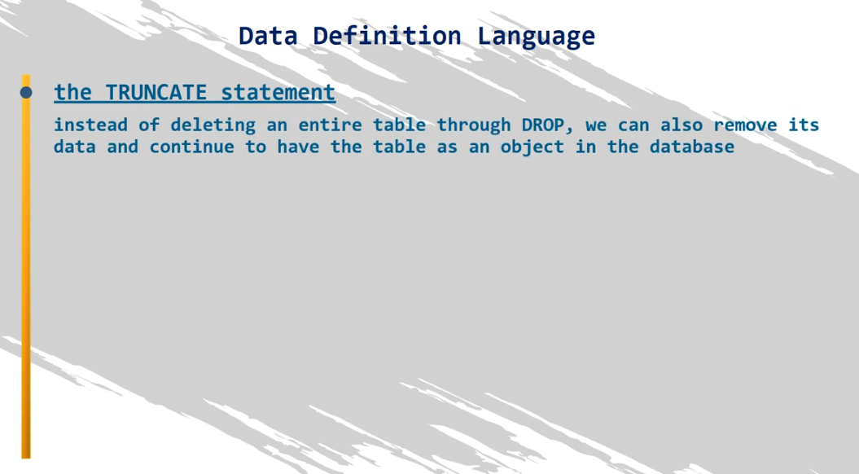

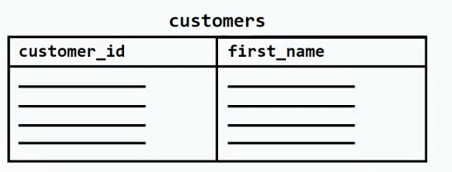
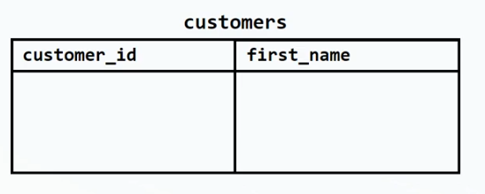

Slide 26
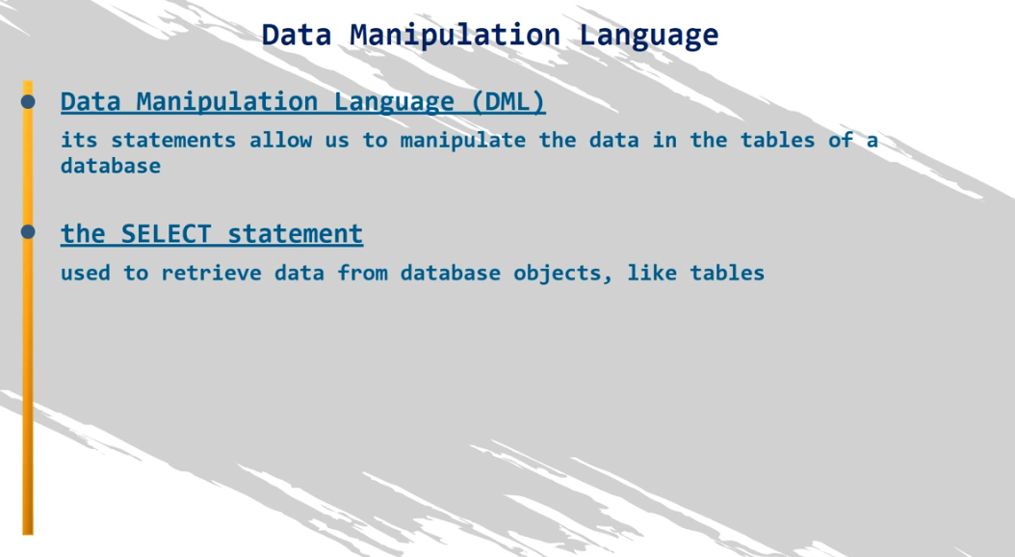
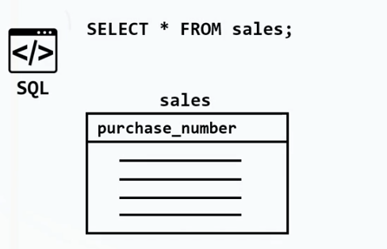

Slide 27

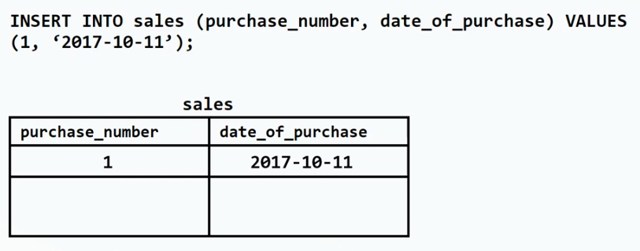

Slide 28

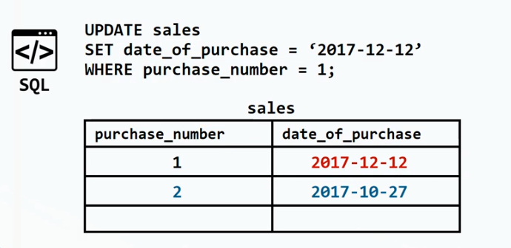

Slide 29
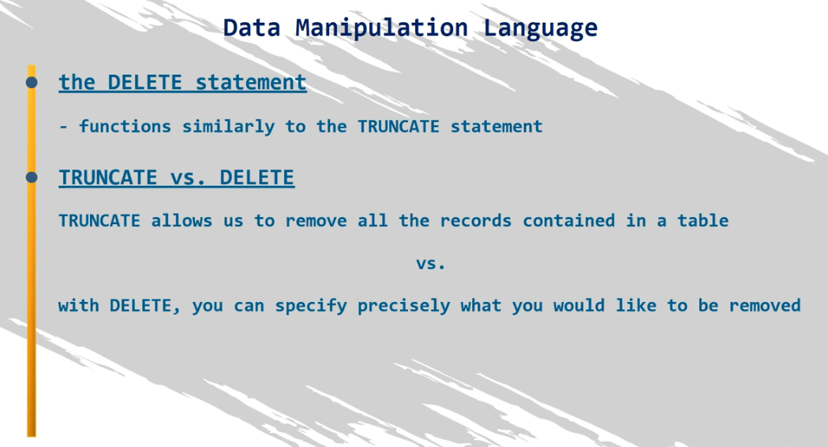

Slide 30
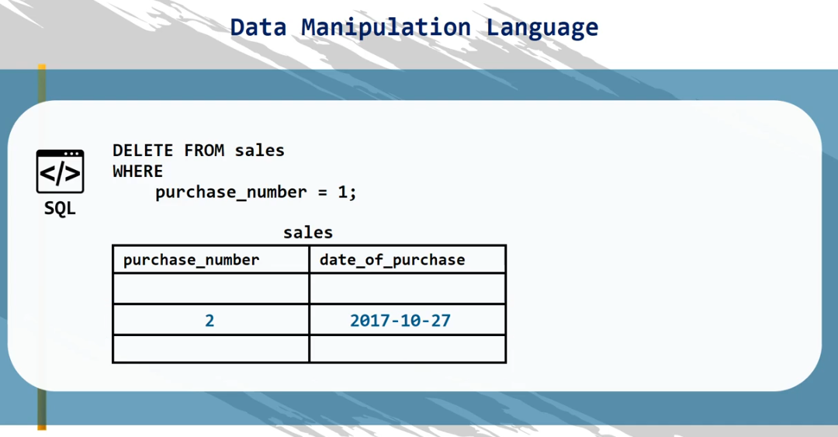

Slide 31
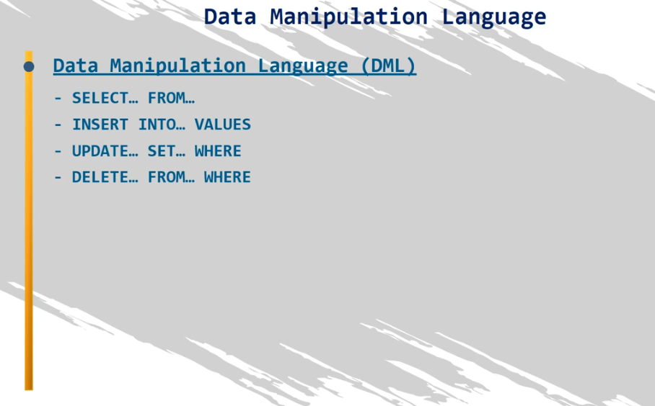

Slide 32
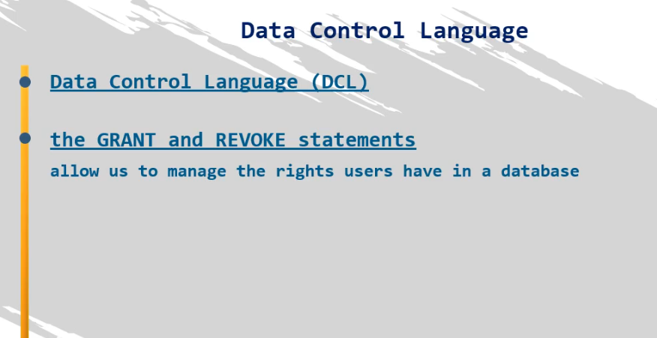

Slide 33
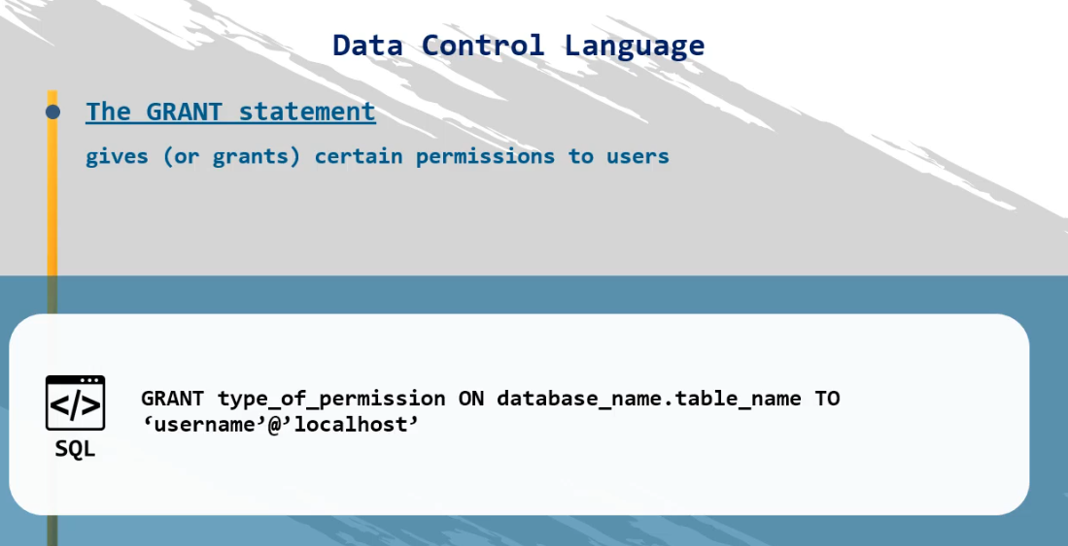

Slide 34
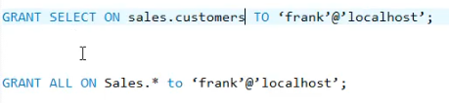

Slide 35
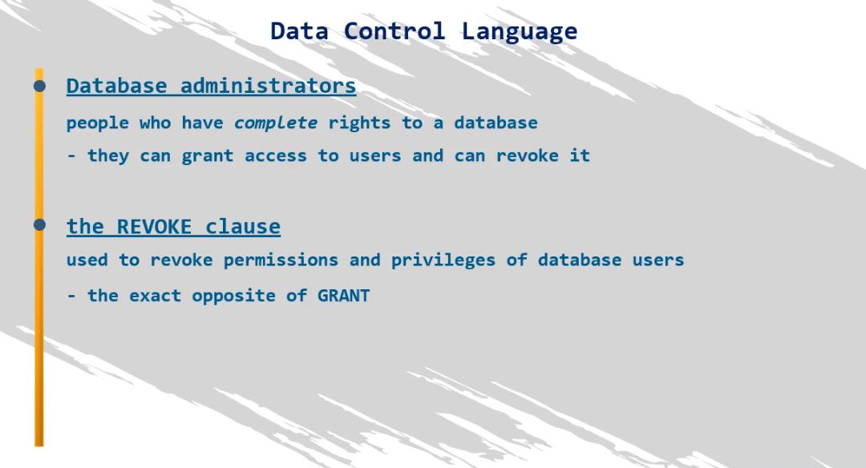


Slide 36
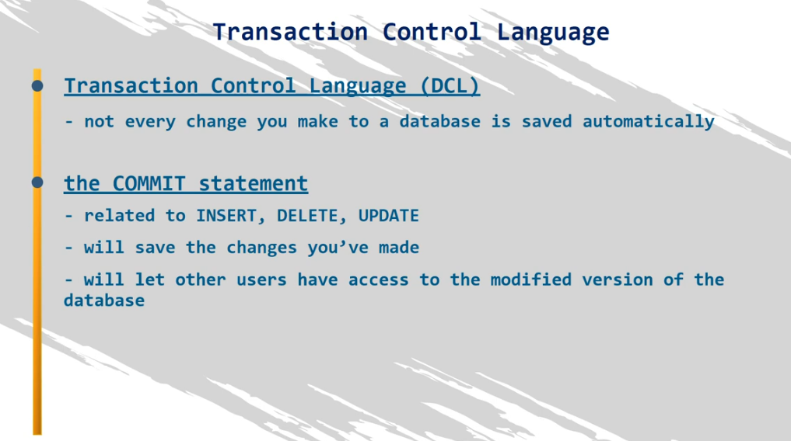
- If any user update the table the another user using the database at the same time cannot see the update if we not commit

Slide 37
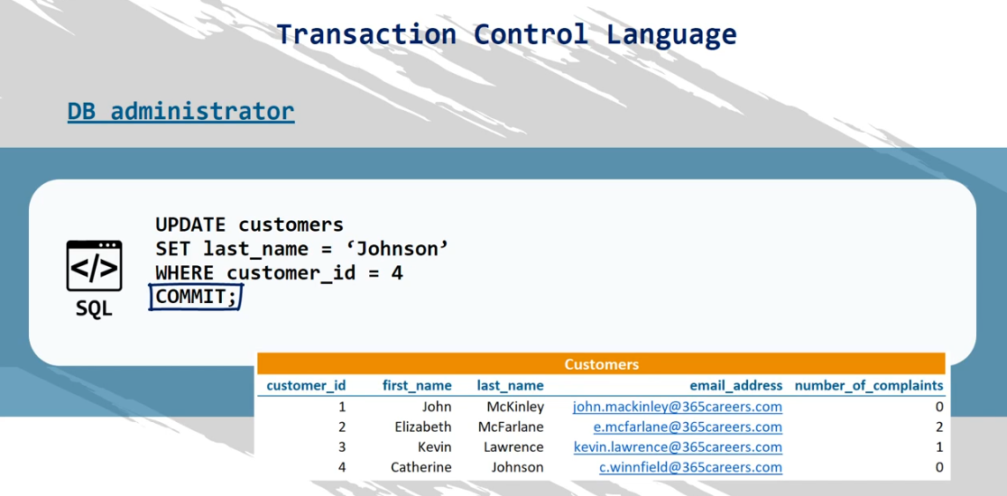

Slide 38
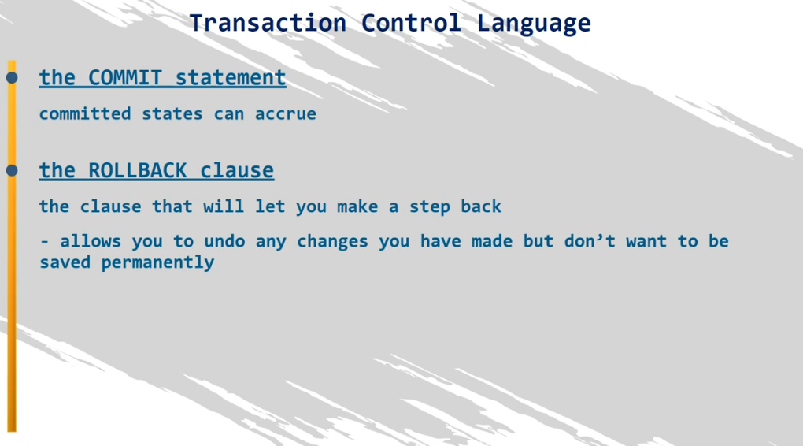

Slide 39
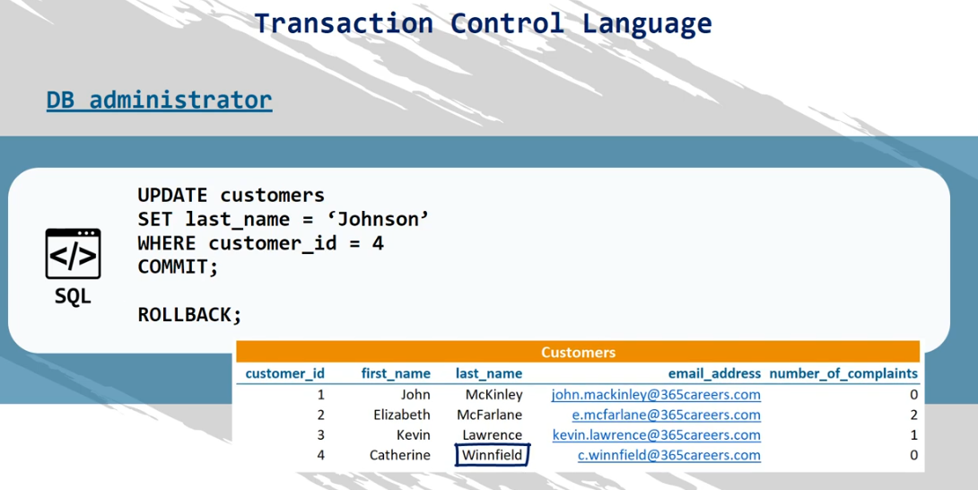

Slide 40
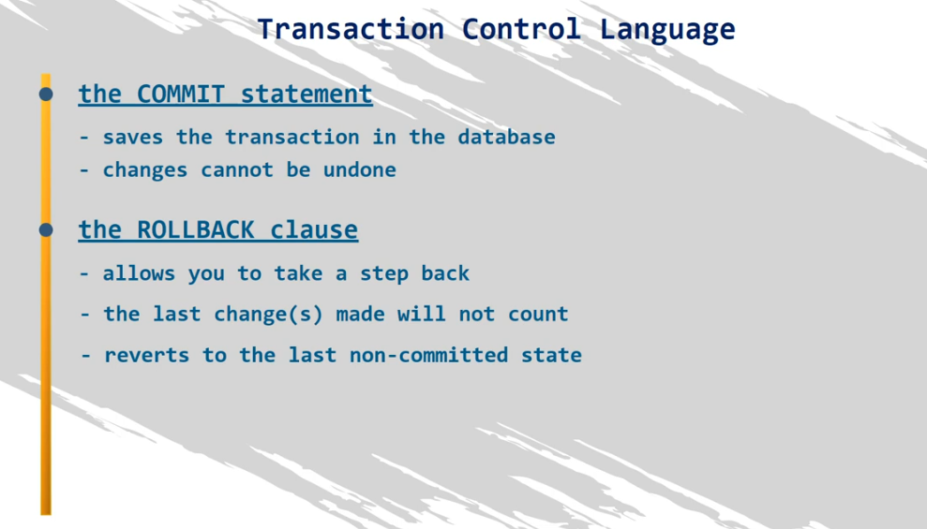

Slide 41
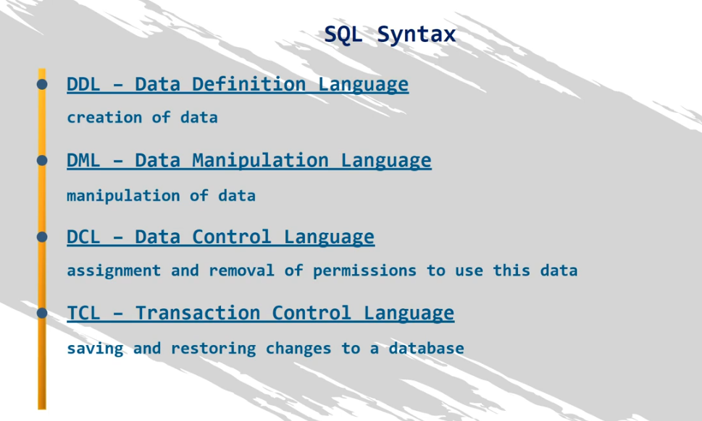

Slide 42
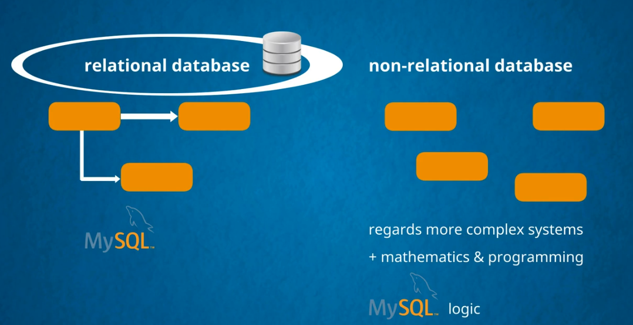

Slide 43
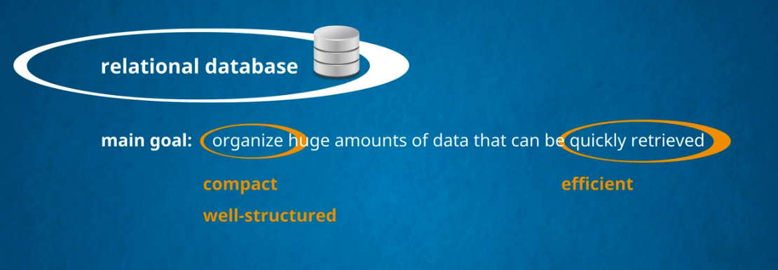

Slide 44
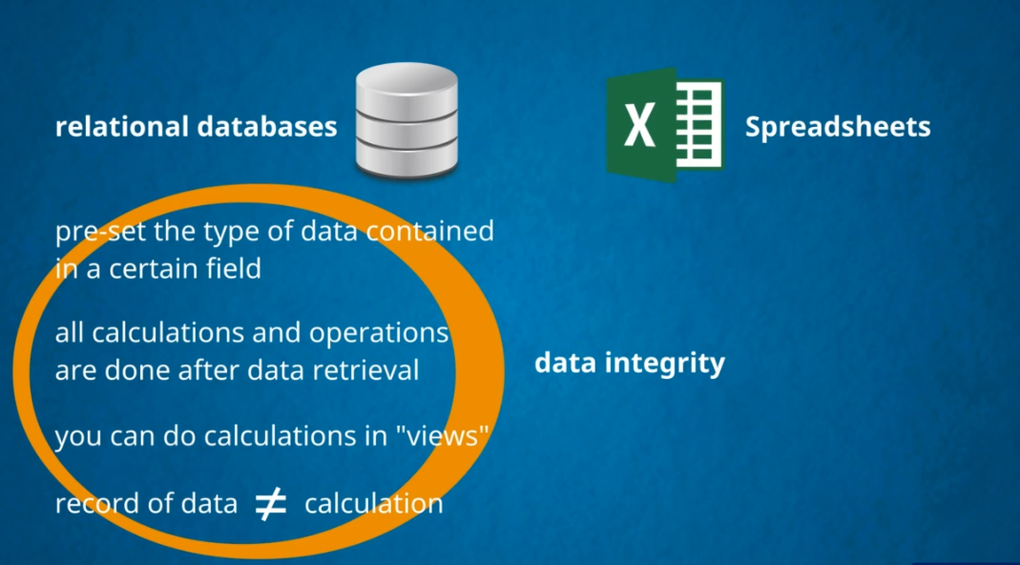



Slide 45



Slide 46
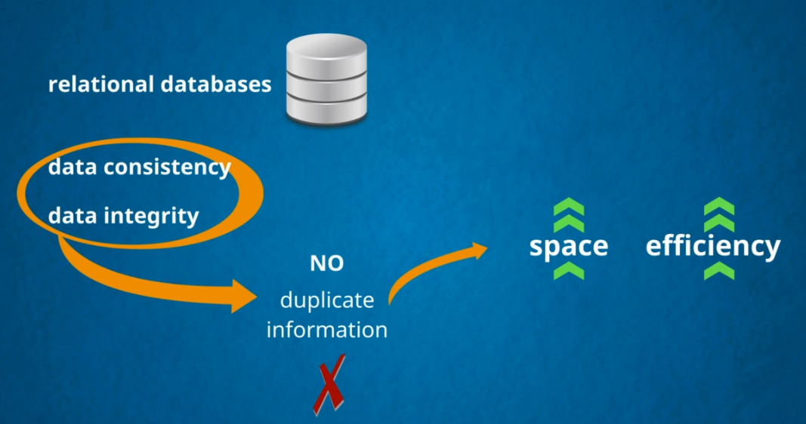

Slide 47


Slide 48



Slide 49


Slide 50


Slide 51


Slide 52


Slide 53


Slide 54


Slide 55



Slide 56


Slide 57


Slide 58


Slide 59


Slide 60


Slide 61


Slide 62


Slide 63


Slide 64


Slide 65


Slide 66


Slide 67


Slide 68


Slide 69


Slide 70




Slide 71


Slide 72


Slide 73



Slide 74


Slide 75


Slide 77


Slide 78


Slide 79


Slide 80


Slide 81


Slide 82


Slide 83


Slide 84


Slide 85



Slide 86


Slide 87

Precision
Scale

Slide 88

Gives warning

Slide 89


Slide 90


Slide 91


Slide 92


Slide 93

Not gives warning

Slide 94


Slide 95


Slide 96


Slide 97


Slide 98


Slide 99


Slide 100



Slide 101

Seconds

Slide 102


Slide 103


Slide 104


Slide 105


Slide 106


Slide 107


If you want to apply auto_increment then the field should be a primary key or unique key or index

Slide 108
create table sales(
purchase_number int not null primary key auto_increment, date_of_purchase date not null, customer_id int, item_code varchar(20)
);

Slide 109



Slide 110


Slide 111


Slide 112


Slide 113


Slide 114


Slide 115

Alternate way of adding primary key

Slide 116


Slide 117


Slide 118


Slide 119



Slide 120


Slide 121

Another way of Adding Foreign Key

Slide 122


sales_ibfk_1
Dropping Foreign Key

Slide 123


Slide 124


Slide 125



Slide 126


Slide 127


Slide 128

Dropping Unique Key

Slide 129


Slide 130


Slide 131


Slide 132

Using Alter

Slide 133

Drop DEFAULT
ALTER TABLE customers
ALTER COLUMN no_of_complaints DROP DEFAULT

Slide 134


Slide 135


Slide 136


Slide 137

Using ALTER

Slide 138


Slide 139


Slide 140
https://www.dropbox.com/sh/ydl7k4286i99nc3/AACAqYB0wAFB6167ovPctNaSa?dl=0
Load the employee.sql in your workbench

Slide 141


Slide 142


Slide 143


Slide 144


Slide 145


Slide 146


Slide 147


Slide 148


Slide 149


Slide 150


Slide 151


Slide 152


OR

Slide 153


Slide 154


Slide 155


Slide 156


Slide 157


Slide 158


NOT

Slide 159


Slide 160

Without IN operator

Slide 161

Using IN

Slide 162

Using NOT IN

Slide 163


Slide 164



First Name starting with mar

Slide 165

First Name Ending with Mar

Slide 166


Slide 167



Slide 168

Using NOT LIKE

Slide 169


Slide 170


Slide 171


Slide 172




Slide 173


Slide 174


Slide 175


Slide 176


Slide 177


Slide 178



Slide 179


Slide 180


Slide 181


Slide 182


Slide 183


Slide 184


Slide 185

Total Number of First Name with Duplicates

Slide 186

Total Number of First Name without Duplicates

Slide 187


Slide 188


Slide 189


Slide 190


Slide 191


Slide 192



Slide 193


Slide 194

Here the sql will first order the list based on first_name in descending order and each first_name group hast the last_name arranged in ascending order

Slide 195


Slide 196


Slide 197


Slide 198


Slide 199

Using GROUP BY instead of DISTINCT

Slide 200


Slide 201


Slide 202


Slide 203

Return only the count of first_name is greater than 250

Slide 204



Slide 205


Slide 206



Slide 207

Accepted Having (aggregate and non-aggregate) condition

Slide 208

Not Accepted Having (aggregate and non-aggregate) condition

Slide 209


Slide 210

SQL FLOW

Slide 211



Slide 212


Slide 213


Slide 214


Slide 215

Copy All values from another table
Copy Specific values from another table

Slide 216


Slide 217


Slide 218


Slide 219

If the where condition is not mentioned it will delete all the information in the table

Slide 220


Slide 221


Slide 222


Slide 223


Slide 224


Slide 225


Slide 226


Slide 227


Slide 228



Slide 229


Slide 230


Slide 231


Slide 232


Slide 233


Slide 234

Here coalesce first sees the dept_manager since it is null it will moves to the dept_name . If the dept_name is not null then it replaces this value for the dept_manager ,if the dept_name column is null then coalesce will move for next argument

Slide 235


Slide 236


Slide 237


Slide 238


Slide 239



Slide 240


Slide 241


Slide 242


Slide 243


Slide 244


Slide 245


Slide 246


Slide 247


Slide 248


Slide 249


Slide 250


Slide 251


Slide 252



Slide 253




Slide 254

Remove Duplicates

Slide 255


The null values are not matched by the inner join hence only non-null values are compared

Slide 256


Slide 257


Slide 258


Slide 260


Slide 261


Slide 262


Slide 263


Slide 264


Slide 265


Slide 266


Slide 267


Slide 268


Slide 269


Slide 270


Slide 271


Slide 272


Slide 273


Slide 274


Slide 275


Slide 276


Slide 277


Slide 278


Slide 279



Slide 280


Slide 281


Slide 282


Slide 283


Slide 284


Slide 285


Slide 286


Slide 287


Slide 288


Slide 289


Slide 290


Slide 291



Slide 292


Slide 293


Slide 294


Slide 295


Slide 296


Slide 297


